Slide 1
Test Strategy
AIT Ericsson MSC
Group project

Slide 2
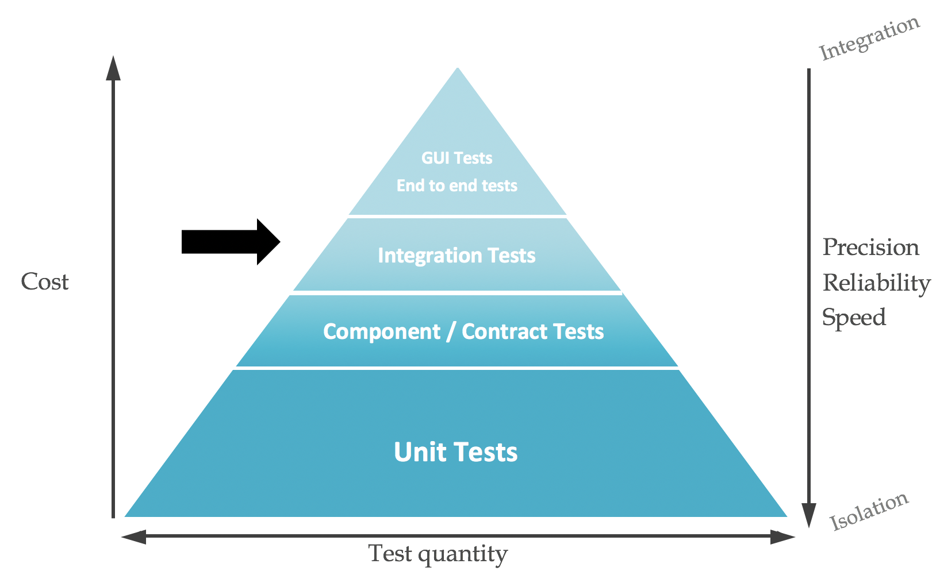
The Test Pyramid

Slide 3

The Test Pyramid
Additional considerations
Does it still work after my recent change
  Multiple people updating at same time
  Future updates by someone else
BDD tests drive the way the product is developed
  New approach to development – which helps test a log
Manual tests
  Do use during development
  Keep to a minimum once dev done----if not remove totally
    (see Exploratory Test)
  Huge cost to repeat
Exploratory
  Important to maintain this test phase
Fault slippage learnings
  Add new tests types of tests as you learn
DEVOPS………..

Slide 4
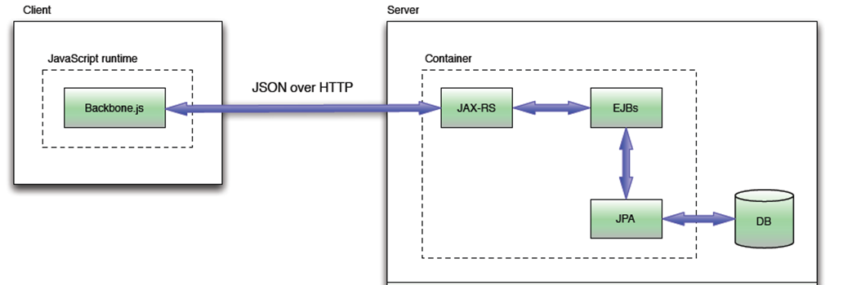
Architecture → Test Architecture

Slide 5
Lets look at how to test this architecture
Client
Rest
Server
UI Solution
JAX-RS
Business Logic Classes
POJO Classes
DAO Classes
DB

Slide 6
There are many ways to test this solution (Manual and Automatic)
Client
Rest
Server
UI Solution
JAX-RS
Business Logic Classes
POJO Classes
DAO Classes
DB

Slide 7
There are many ways to test this solution (Manual and Automatic)
End to end Manual Tests
UI unit tests
Client
Rest
Server
Class based unit tests
UI Solution
JAX-RS
Business Logic Classes
POJO Classes
DAO Classes
DB

Slide 8
There are many ways to test this solution (Manual and Automatic)
End to end Manual Tests
UI -> REST Mock
Rest -> Real server Integration tests
Behaviour based unit tests
DAO – real DB integration test
Behaviour unit tests -> mocked DB/DAO layer
UI unit tests
Client
Rest
Server
Class based unit tests
UI Solution
JAX-RS
Business Logic Classes
POJO Classes
DAO Classes
DB

Slide 9

There are many ways to test this solution (Manual and Automatic)
End to end Manual Tests
UI -> REST Mock
Rest -> Real server Integration tests
Behaviour based unit tests
DAO – real DB integration test
Behaviour unit tests -> mocked DB/DAO layer
UI unit tests
Client
Rest
Server
Class based unit tests
UI Solution
JAX-RS
Business Logic Classes
POJO Classes
DAO Classes
DB

Slide 10

Proposed Automated Test Strategy based on best practices
(Plus exploratory manual tests)
UI -> REST Mock
UI Use cases (Selenium)
Rest -> Real server Integration tests (Queries)
Behaviour unit tests (Cucumber) (Consistency Checks)
Optional extra
Behaviour unit tests -> mocked DB/DAO layer (Mokito )(error / edge cases)
Client
Rest
Server
UI Solution
JAX-RS
Business Logic Classes
POJO Classes
DAO Classes
DB

Slide 11
Proposed Automated Test Strategy based on best practices
(Plus exploratory manual tests)
UI -> REST Mock
UI Use cases (Selenium)
Rest -> Real server Integration tests (Queries) (Using Arquillian + Rest invocation)
Behaviour unit tests -> mocked DB/DAO layer (Mokito )(error / edge cases)
Behaviour unit tests (Cucumber) (Consistency Checks)
Client
Rest
Server
UI Solution
JAX-RS
Business Logic Classes
POJO Classes
DAO Classes
DB

Slide 12
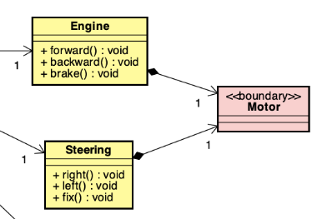
Proposed Automated Test Strategy – visualise design tests
Behaviour unit tests -> mocked DB/DAO layer (Mokito )(error / edge cases)
Behaviour unit tests (Cucumber) Consistency Checks)
Design time : more detailed test structure,
as solution develops
Suggest populate this and visualise tests
around the design
OR – start with BDD and that will drive design!
Client
Rest
Server
UI Solution
JAX-RS
Business Logic Classes
POJO Classes
DAO Classes
DB

Slide 13
High level test strategy steer Jan 2020 V1.0
Do not unit test pojos
Do test business logic classes / interfaces / behaviours
Not chasing coverage – want effective tests,
  And lets see where coverage lands!
  If gaps – that’s a bad smell that needs investigation
Consistency check functionality
  Useful problem to implement a particular test strategy called example mapping (google it)
  BDD – Think about the Behaviour before you implement a solution
  – and right some examples - > tests
Integration testing
  DAO layer tests
    Implement 1st few initial use cases, i.e. import, 1-2 user CRUDs / queries – stop after that
  REST API tests (Queries)
    REST, Business logic and DAO and DB
    Deploy all these in Arqillian (Will get an arquillian guru for that)
    User rest assured to call REST API and assert query response is correct
UI testing
  Manual plugging it together to get it working – agreeing REST API will be key – capture it!
  Later run Selenium to a running back end.
  **** there are new techniques to autogenerate a stub of the REST API and test the UI against that ………may get that far – lets see.
Draw / show your test strategy as per strategy outline above
1-2 hour session – example mapping
Create examples with PO
Team then go off and write gerkin and more…
2 per team at that session?
Or do we leave that for now? When W6 next!
Experimental – need you / to support them after
DAO - Mary – same as before? Mayke - when
REST API – arquillain full stack + rest assured
Mayke plumbing when ?first sprint ??????
I show a rest assured example (Karate ?)
They go from there. What coverage?
Not working 100% yet.
When W9 – first week second sprint
Or do we leave that for now?
- Doable – 1-2 hour session + plumbing session

